Slide 1
Module 1
With Amina, Emily, Julia, and Morgan

Slide 2
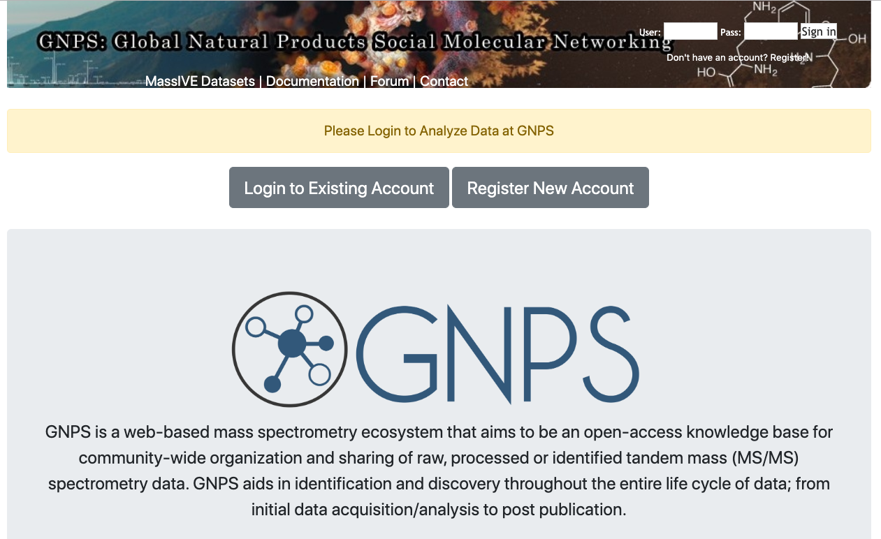
Creating an Account
https://gnps.ucsd.edu/

Slide 3
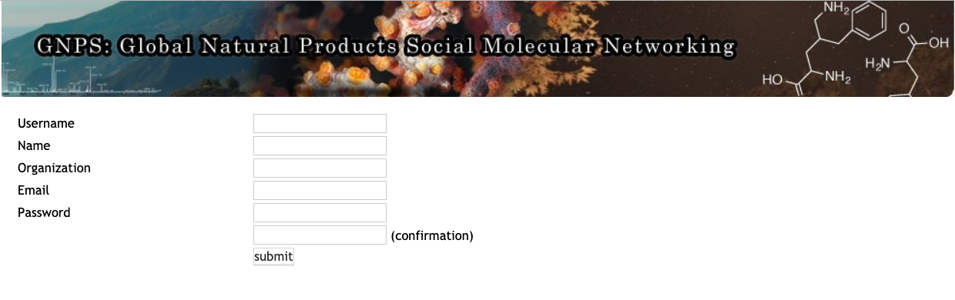

Slide 4

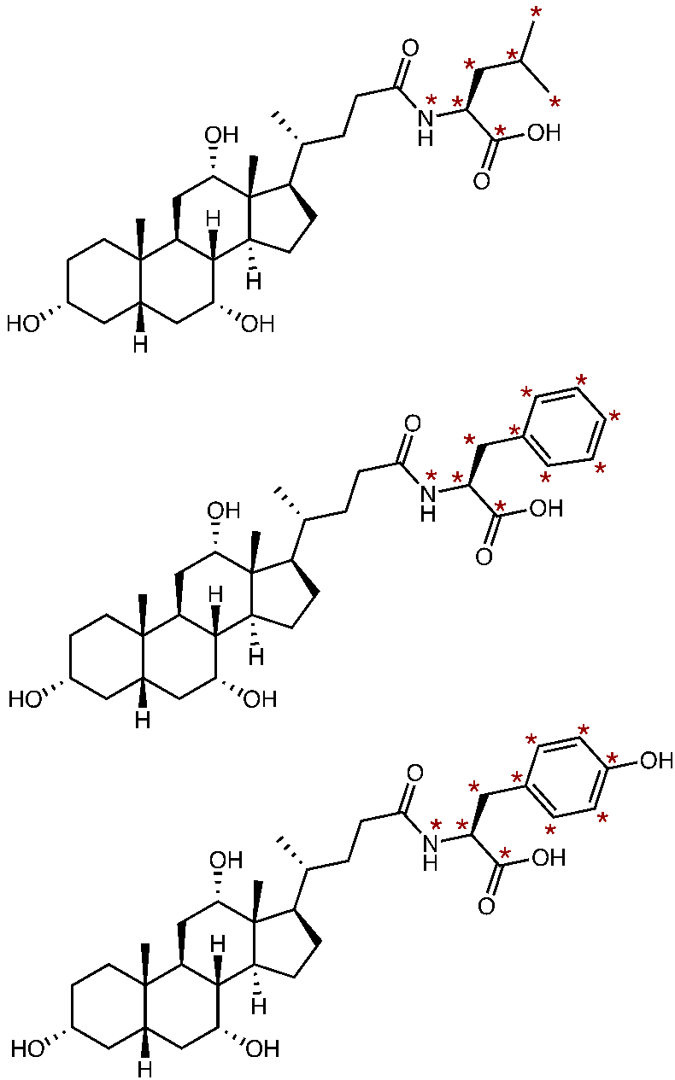


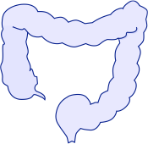
Datasets for Submission
Two Diets
Three Bile Acids
Three Tissue Types
Leu-CA
Liver
Normal Chow
Small Intestine
Phe-CA
Protein Restricted Diet
Large Intestine
Tyr-CA
Mouse drawing c/o Morgan Panitchpakdi

Slide 5
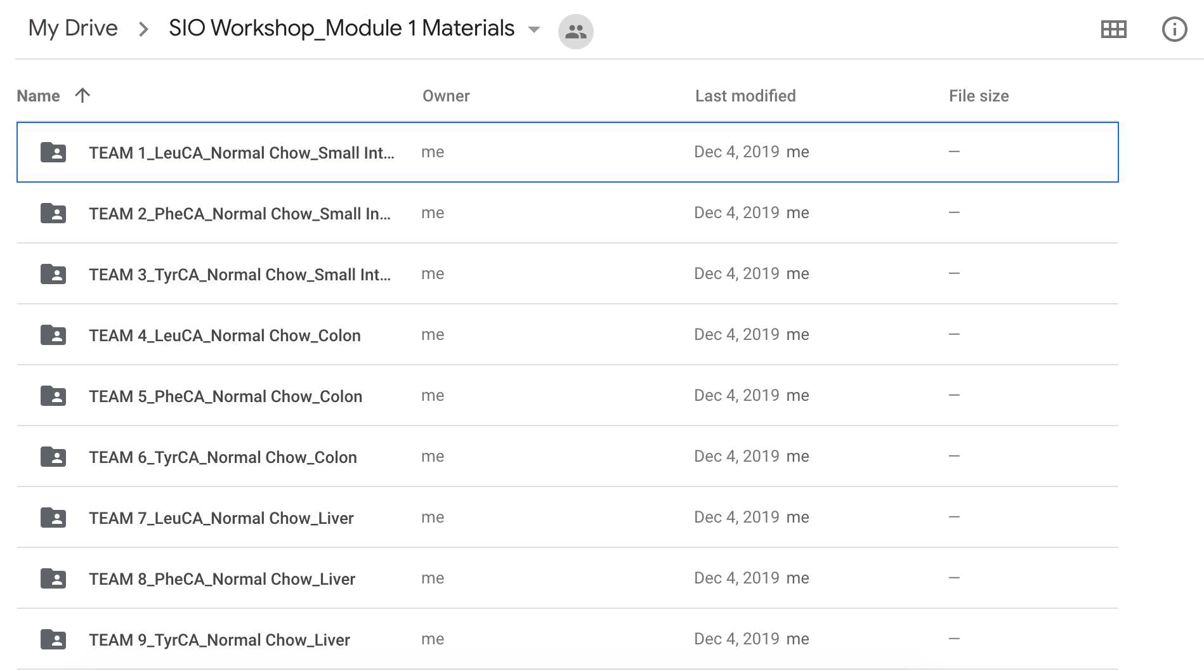
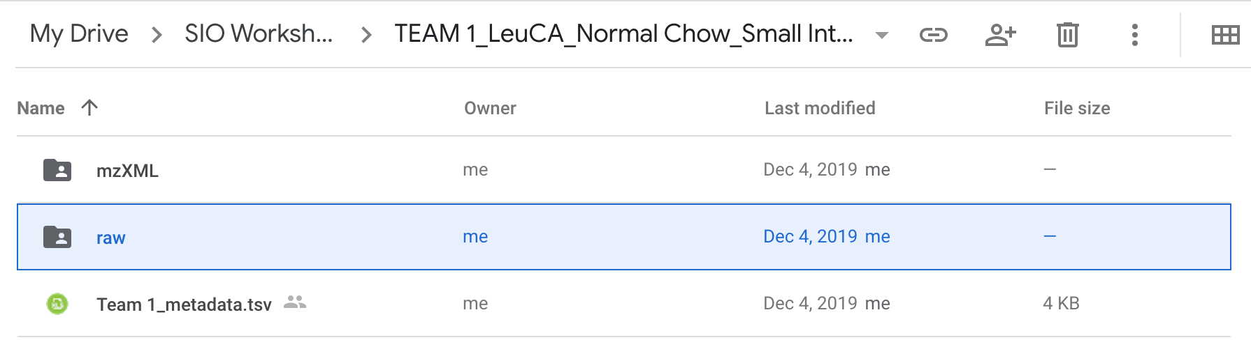
Datasets for Submission
Find them here: https://drive.google.com/drive/folders/1qny47s0iydhBKGZziveXXrnEravjcJ_T?usp=sharing

Slide 6
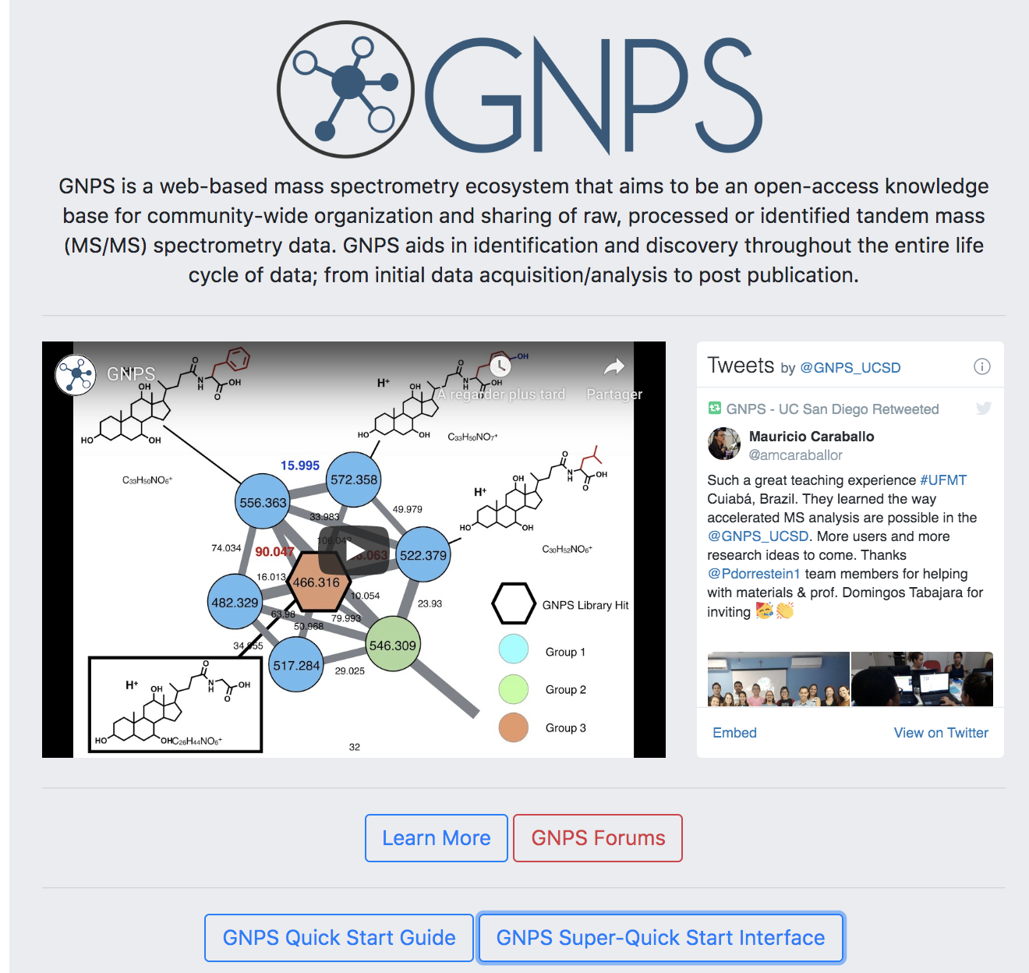
Converting data in GNPS
https://gnps.ucsd.edu/

Slide 7
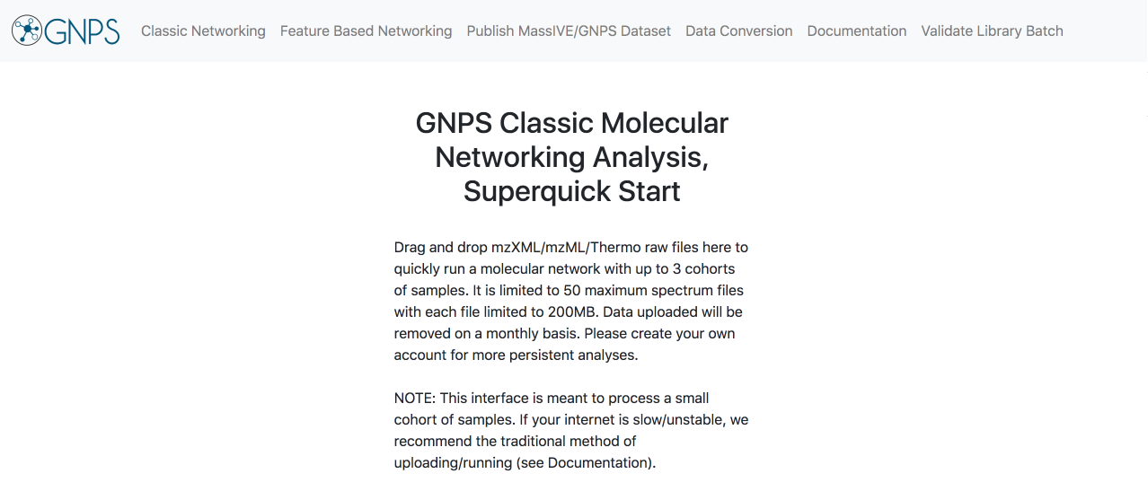
Converting data in GNPS

Slide 8
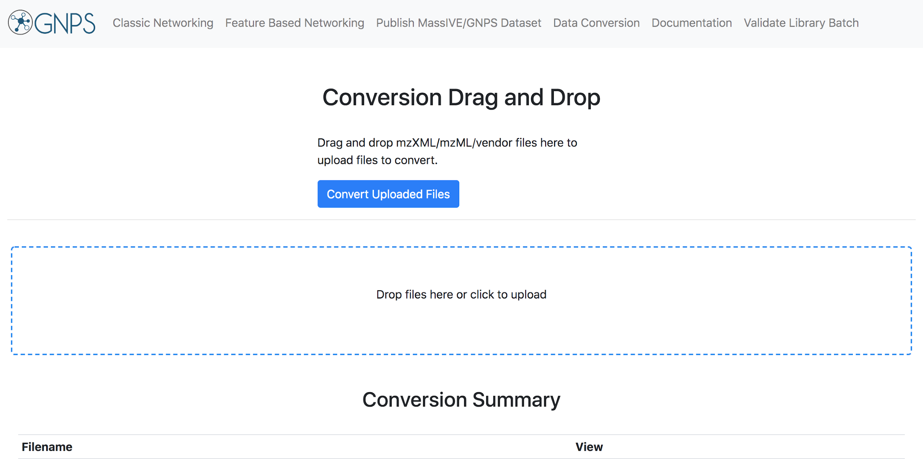
Converting data in GNPS
2)
1)

Slide 9
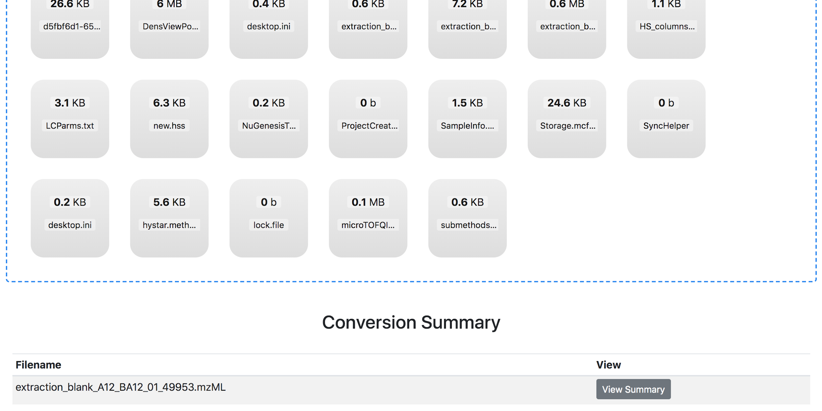
Converting data in GNPS
Look at your download folder!

Slide 10
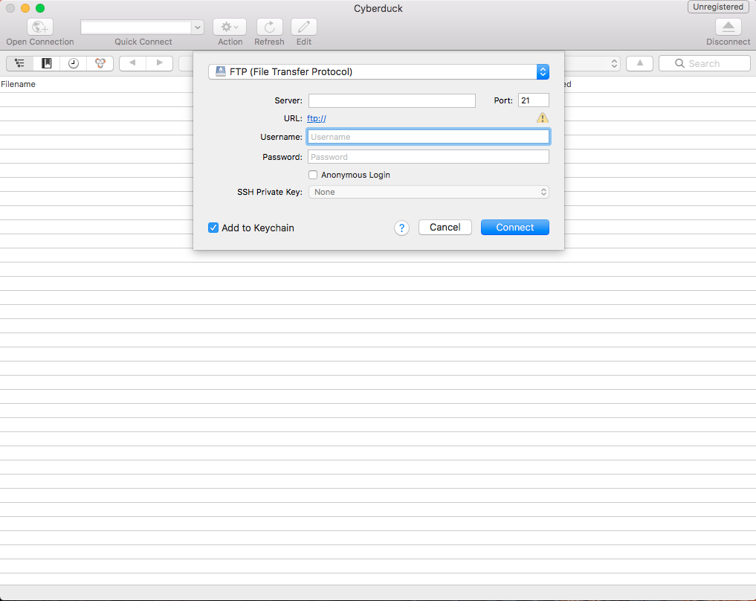
Uploading data to GNPS
https://cyberduck.io/download/

Slide 11
Uploading data to GNPS
ccms-ftp01.ucsd.edu

Slide 12
Uploading data to GNPS
Same as your GNPS login

Slide 13
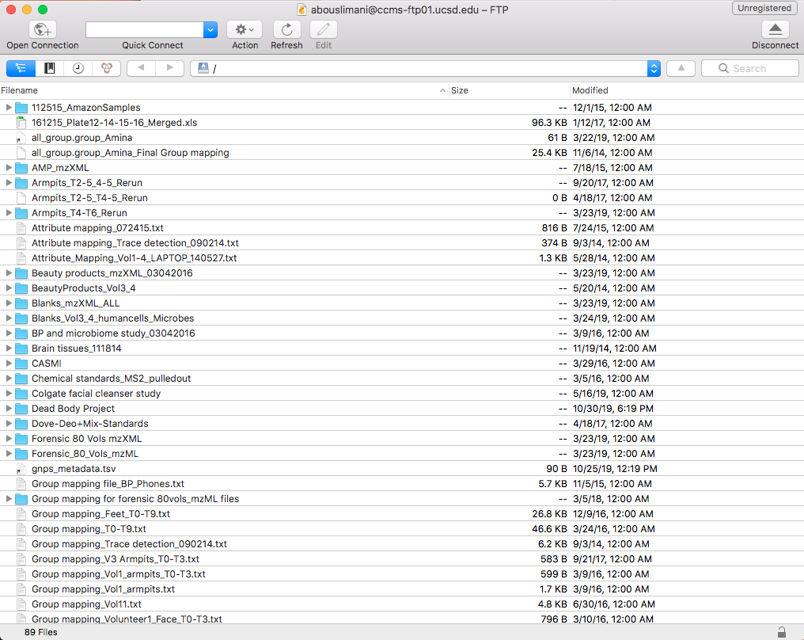
Uploading data to GNPS

Slide 14
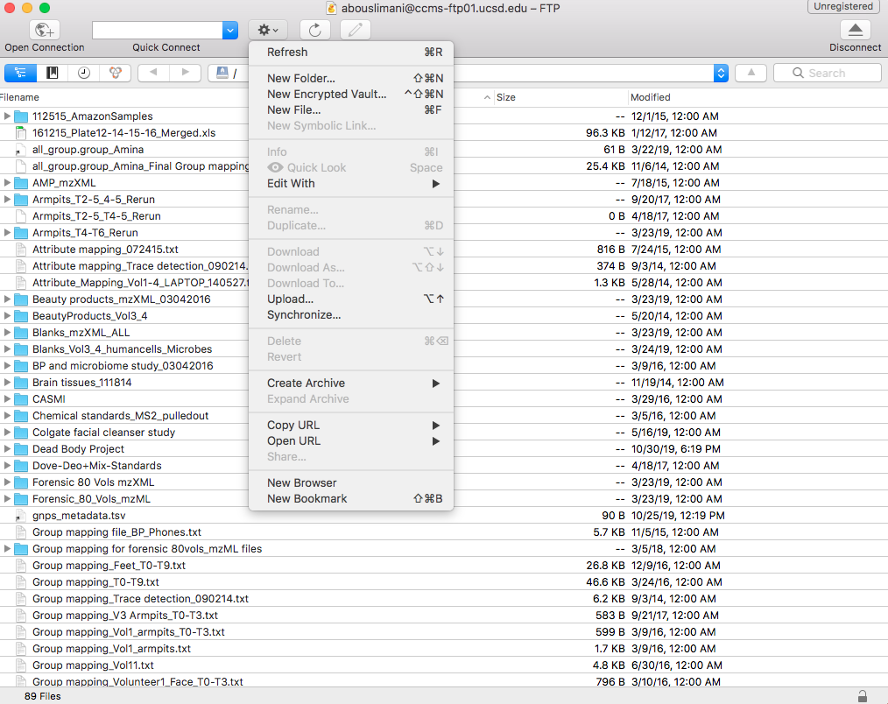
Uploading data to GNPS

Slide 15
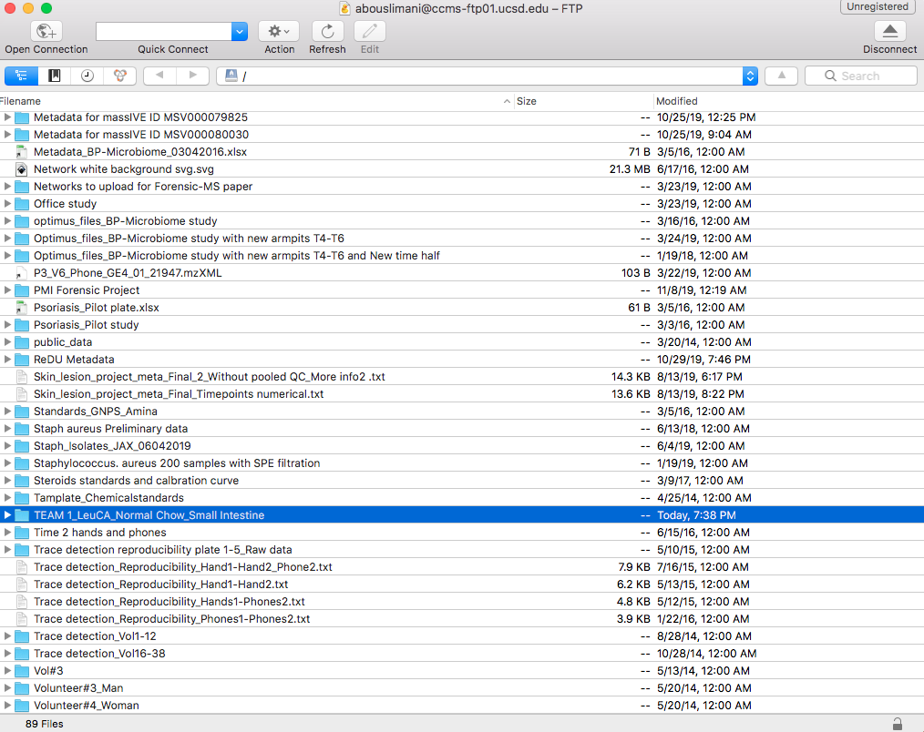
Uploading data to GNPS

Slide 16
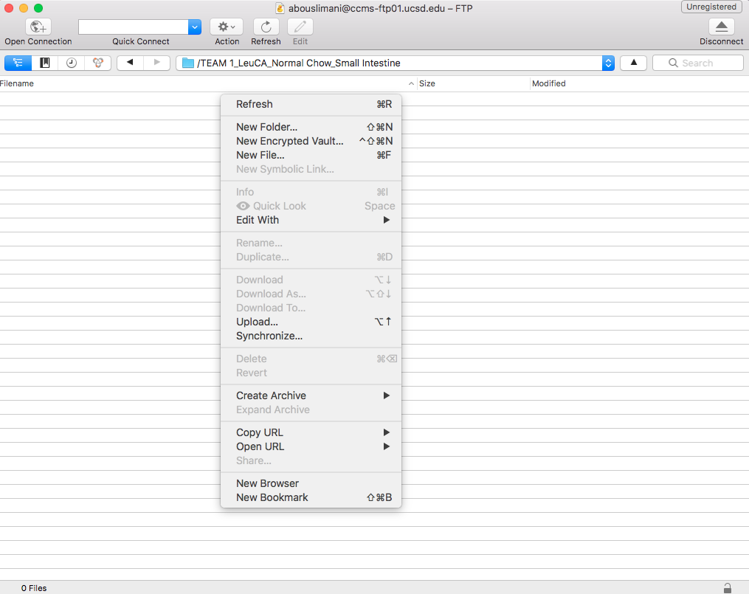
Uploading data to GNPS

Slide 17
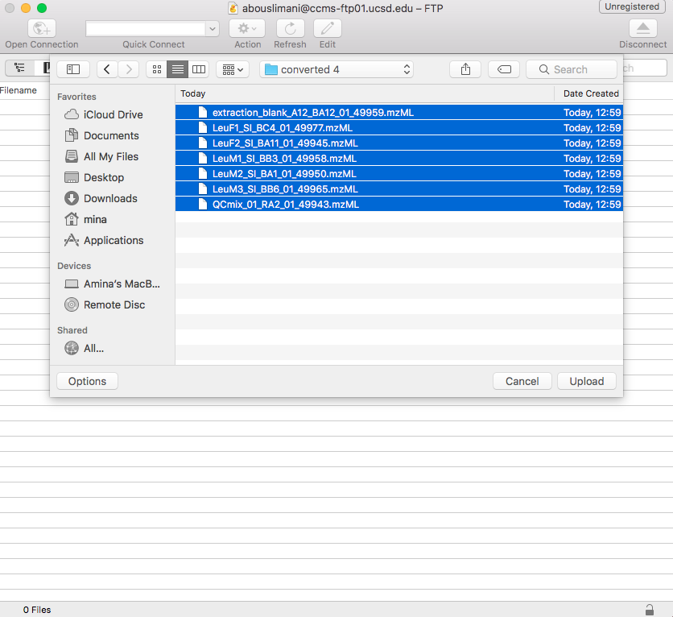
Uploading data to GNPS

Slide 18
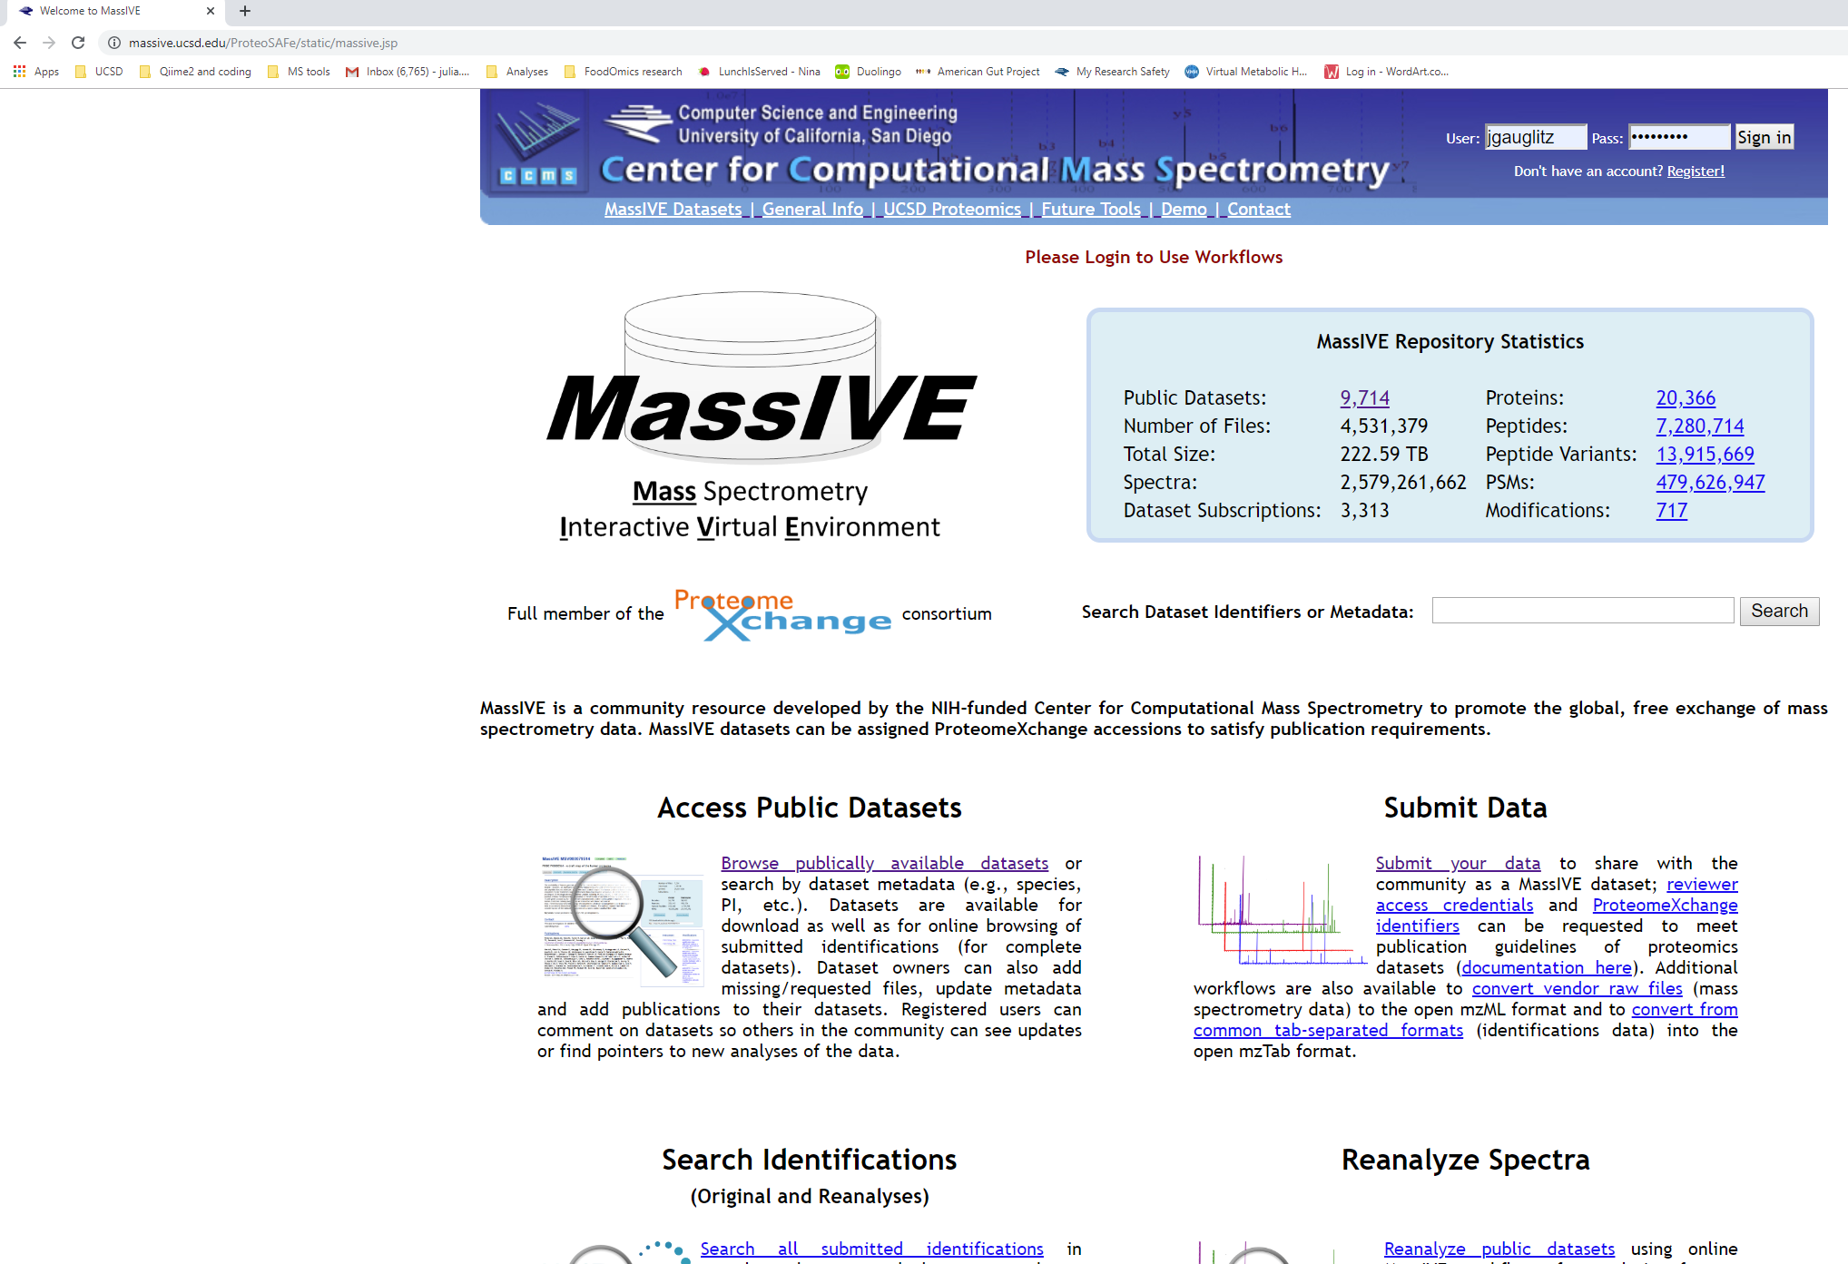
Submitting GNPS-MassIVE dataset
Massive.ucsd.edu
(same login as gnps)
Log in to account
Click on ‘Submit your data’

Slide 19
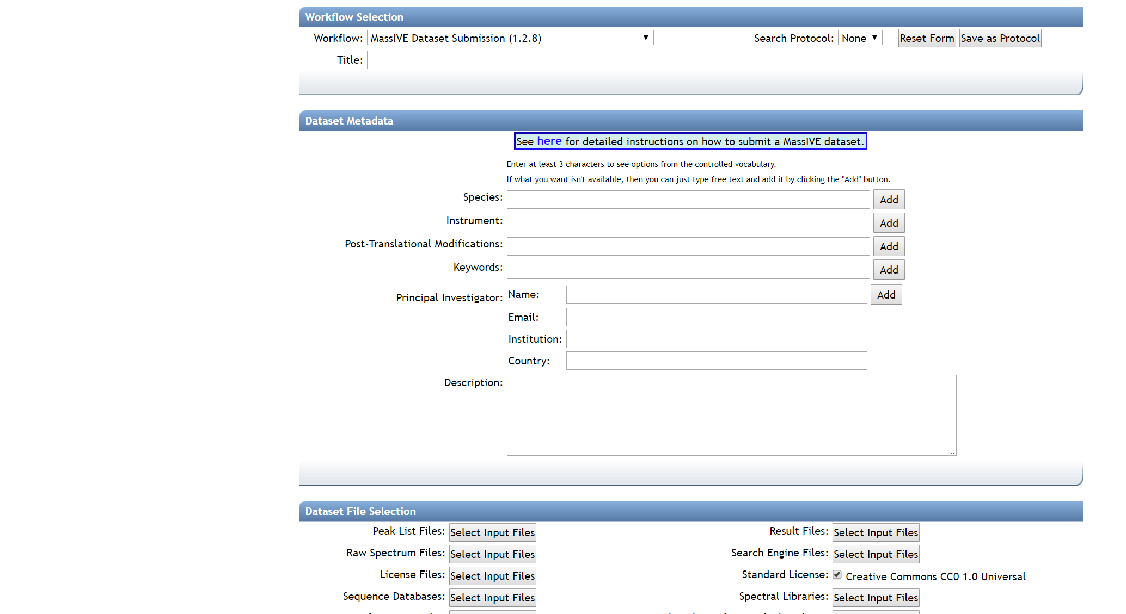
Submitting GNPS-MassIVE dataset
Start Title with ‘GNPS’
Click to access files you just uploaded!

Slide 20
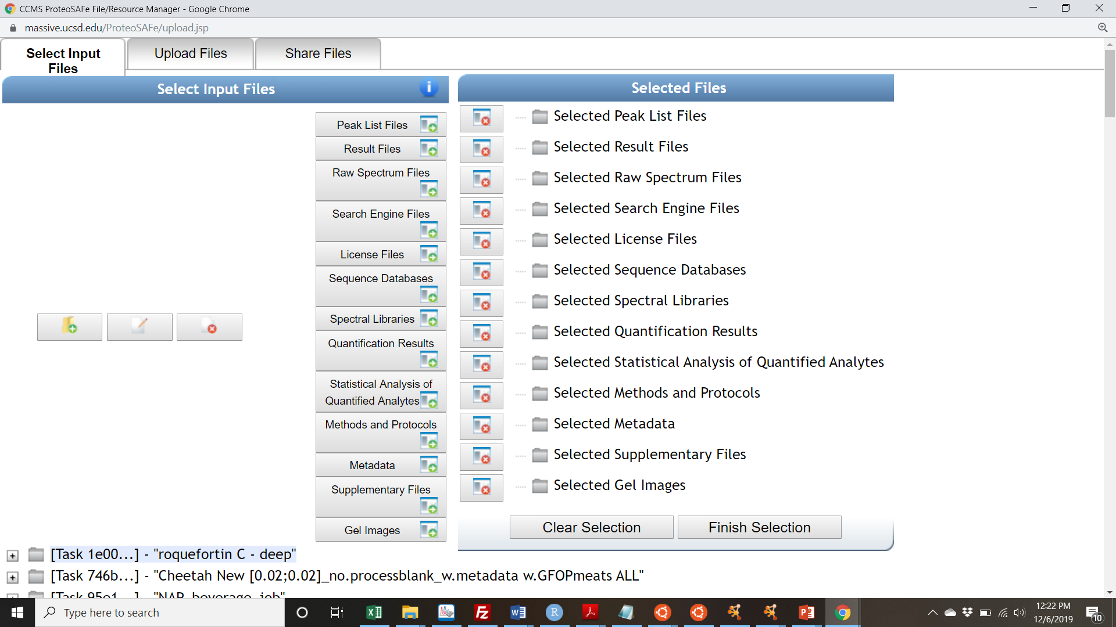
Submitting GNPS-MassIVE dataset
Scroll down and select files
You uploaded using FTP

Slide 21
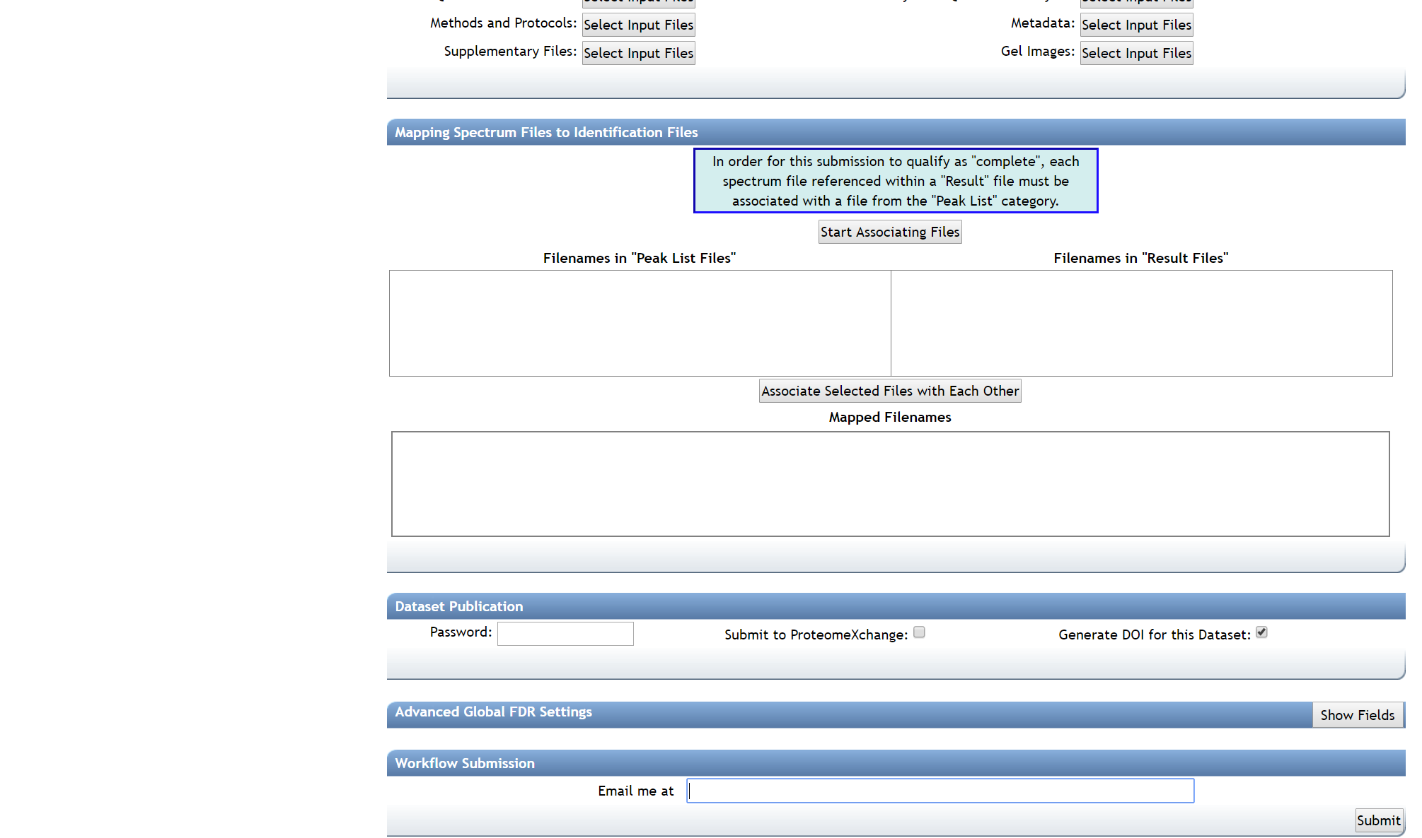
Submitting GNPS-MassIVE dataset

Slide 22
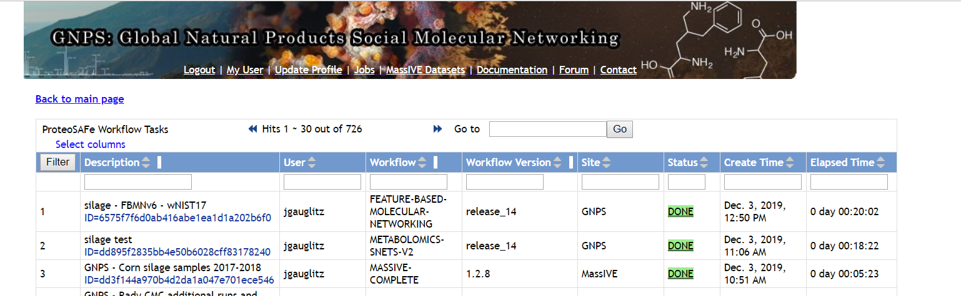
Making GNPS-MassIVE dataset public
Follow email link that job has completed
Proceed to next step
Click on ‘Jobs’ link on GNPS website
Identify the MassIVE dataset
Click on ‘DONE’
OR

Slide 23
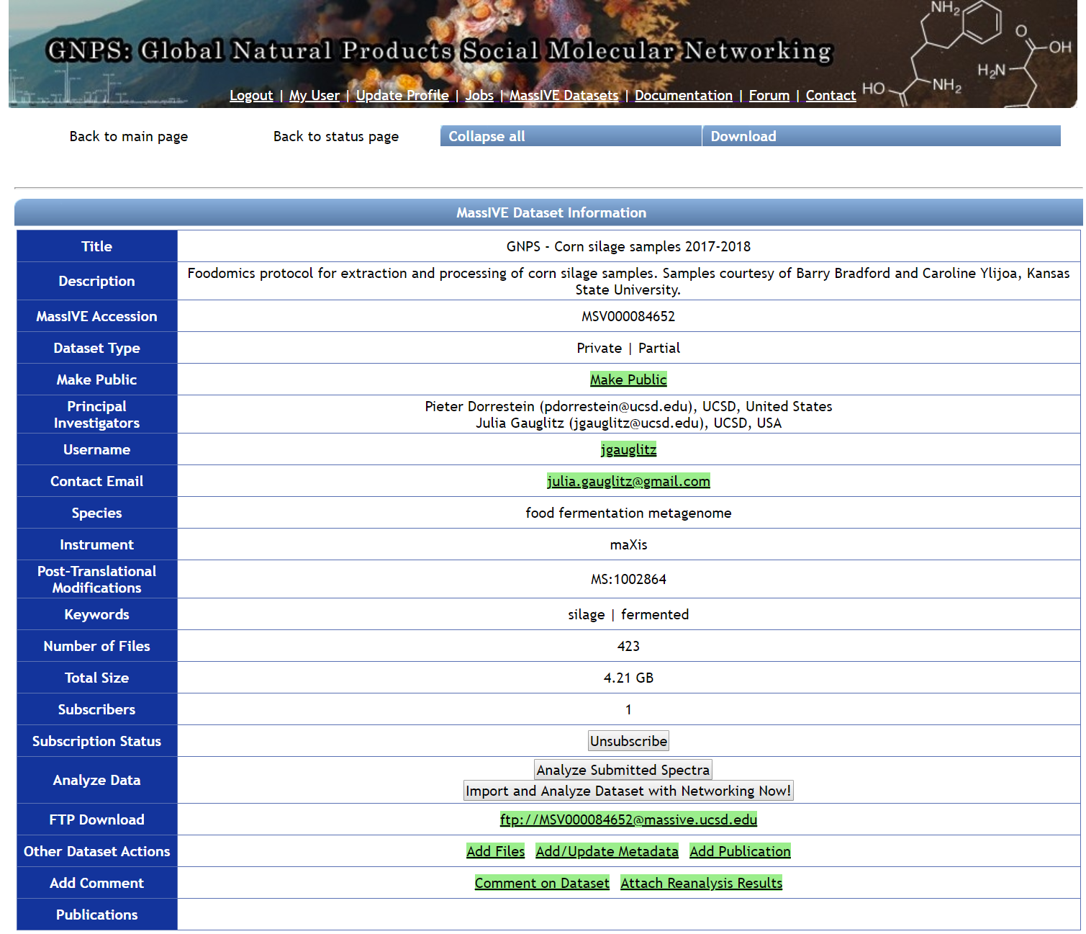
Making GNPS-MassIVE dataset public
Current status
Click on make public

Slide 24
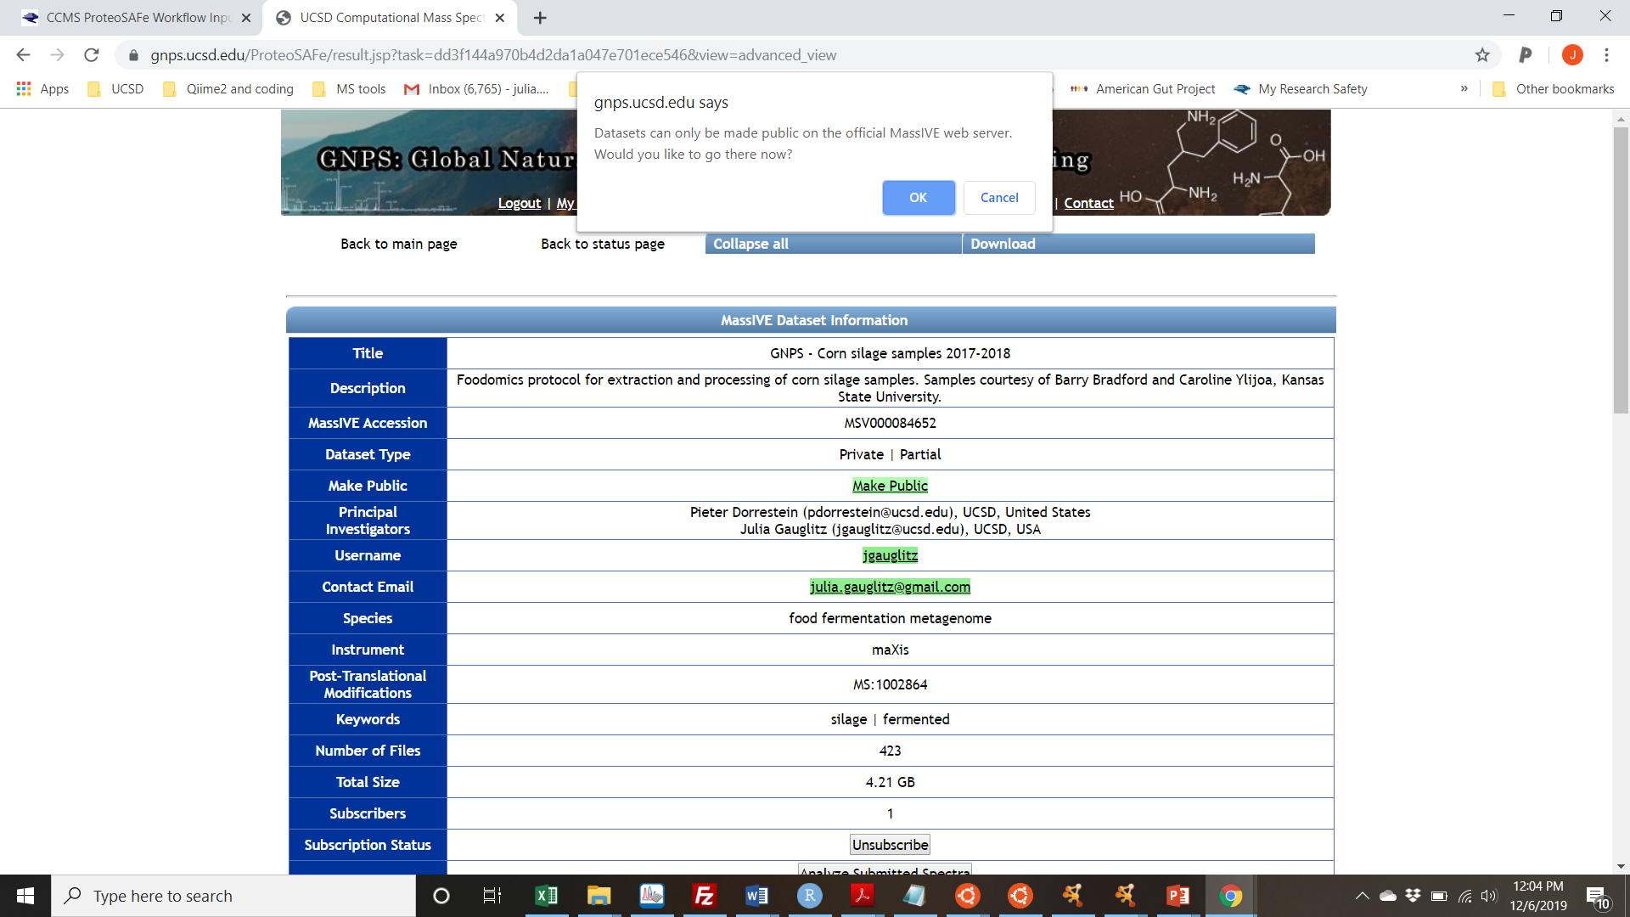

Slide 25
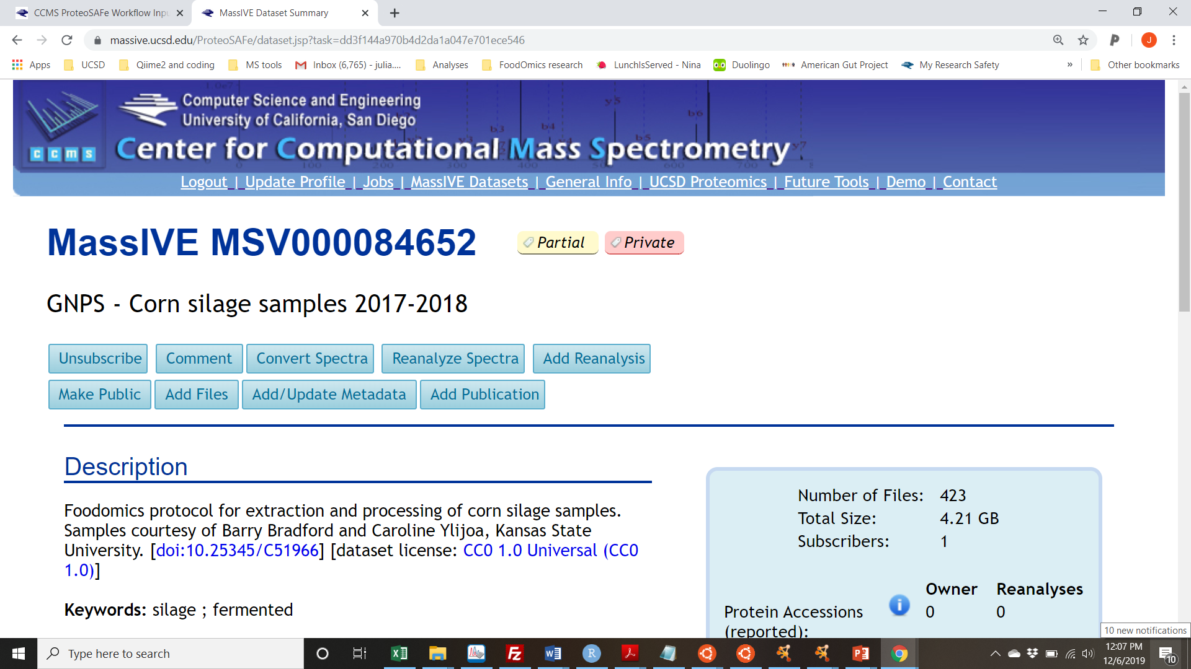

Slide 26
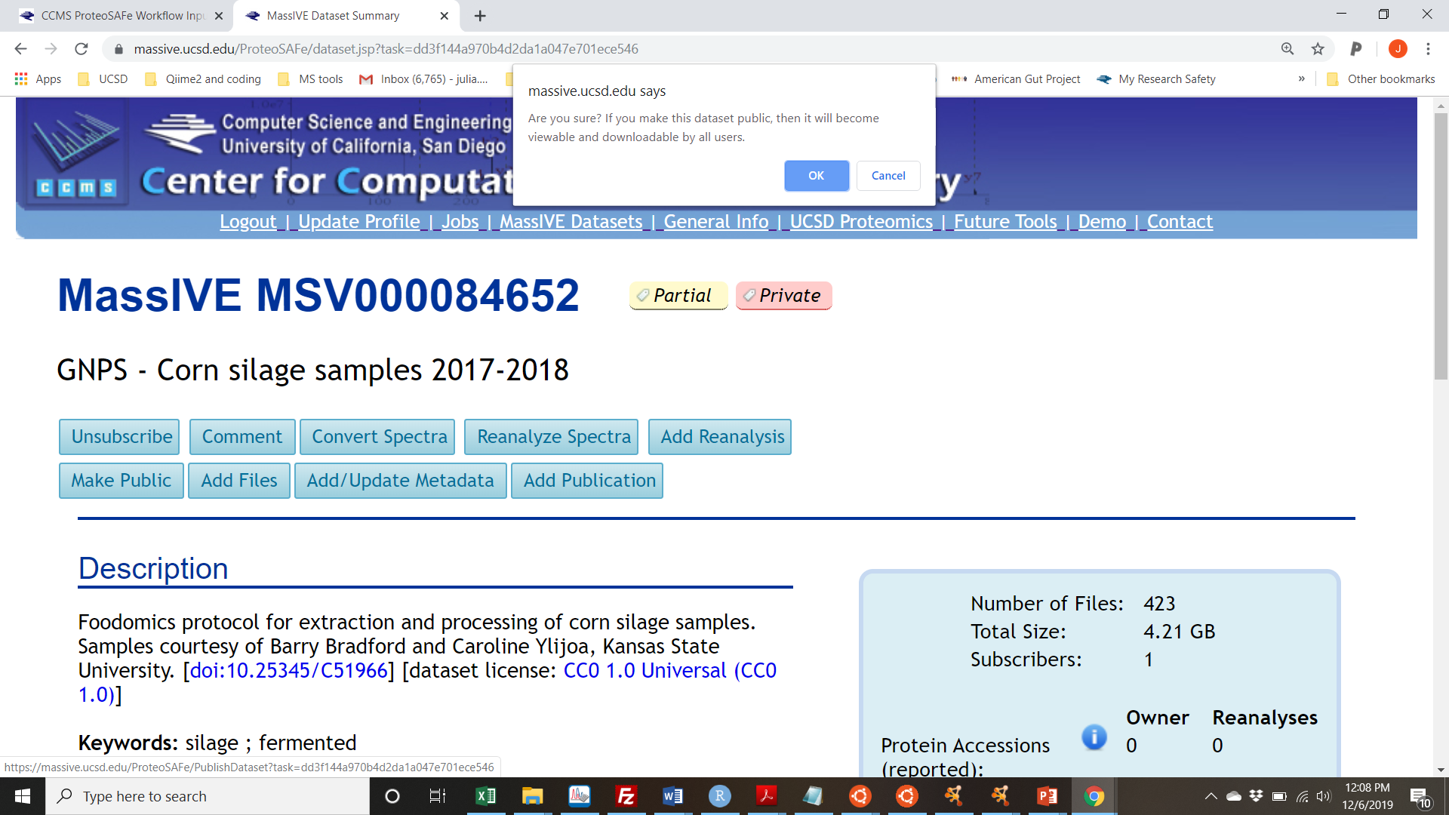
YES!

Slide 27
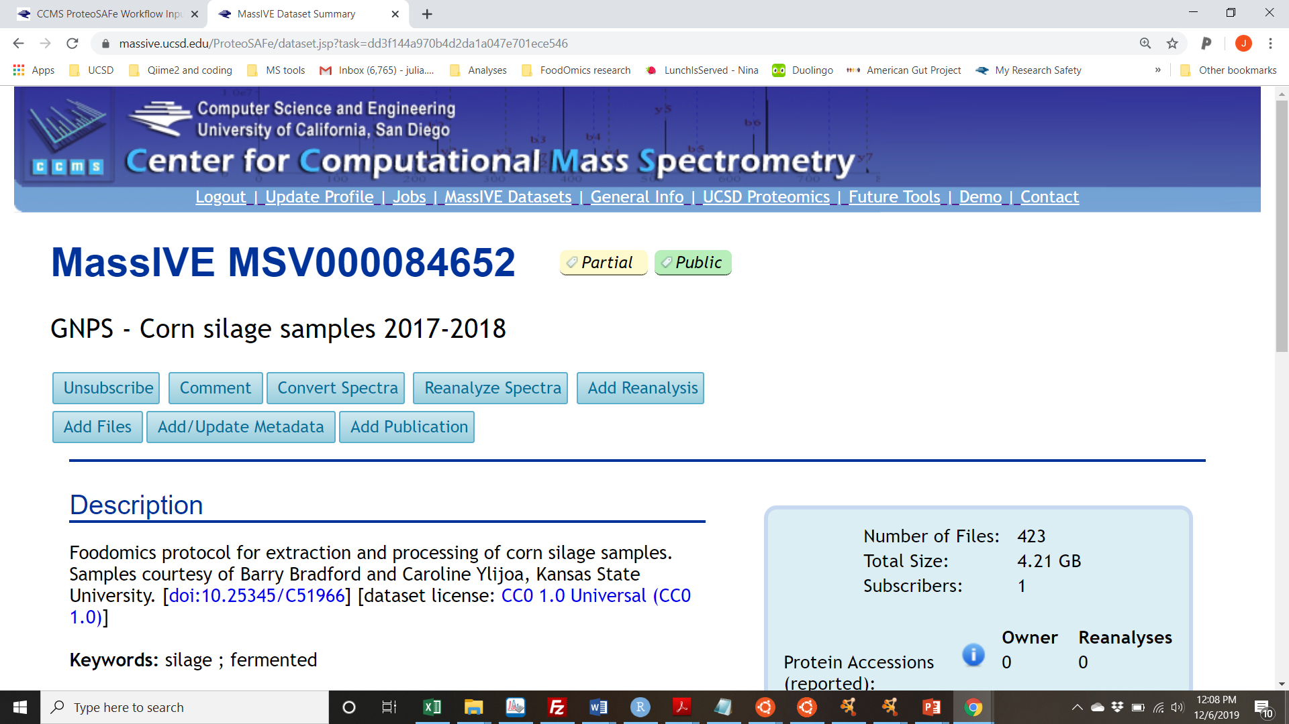

Slide 28
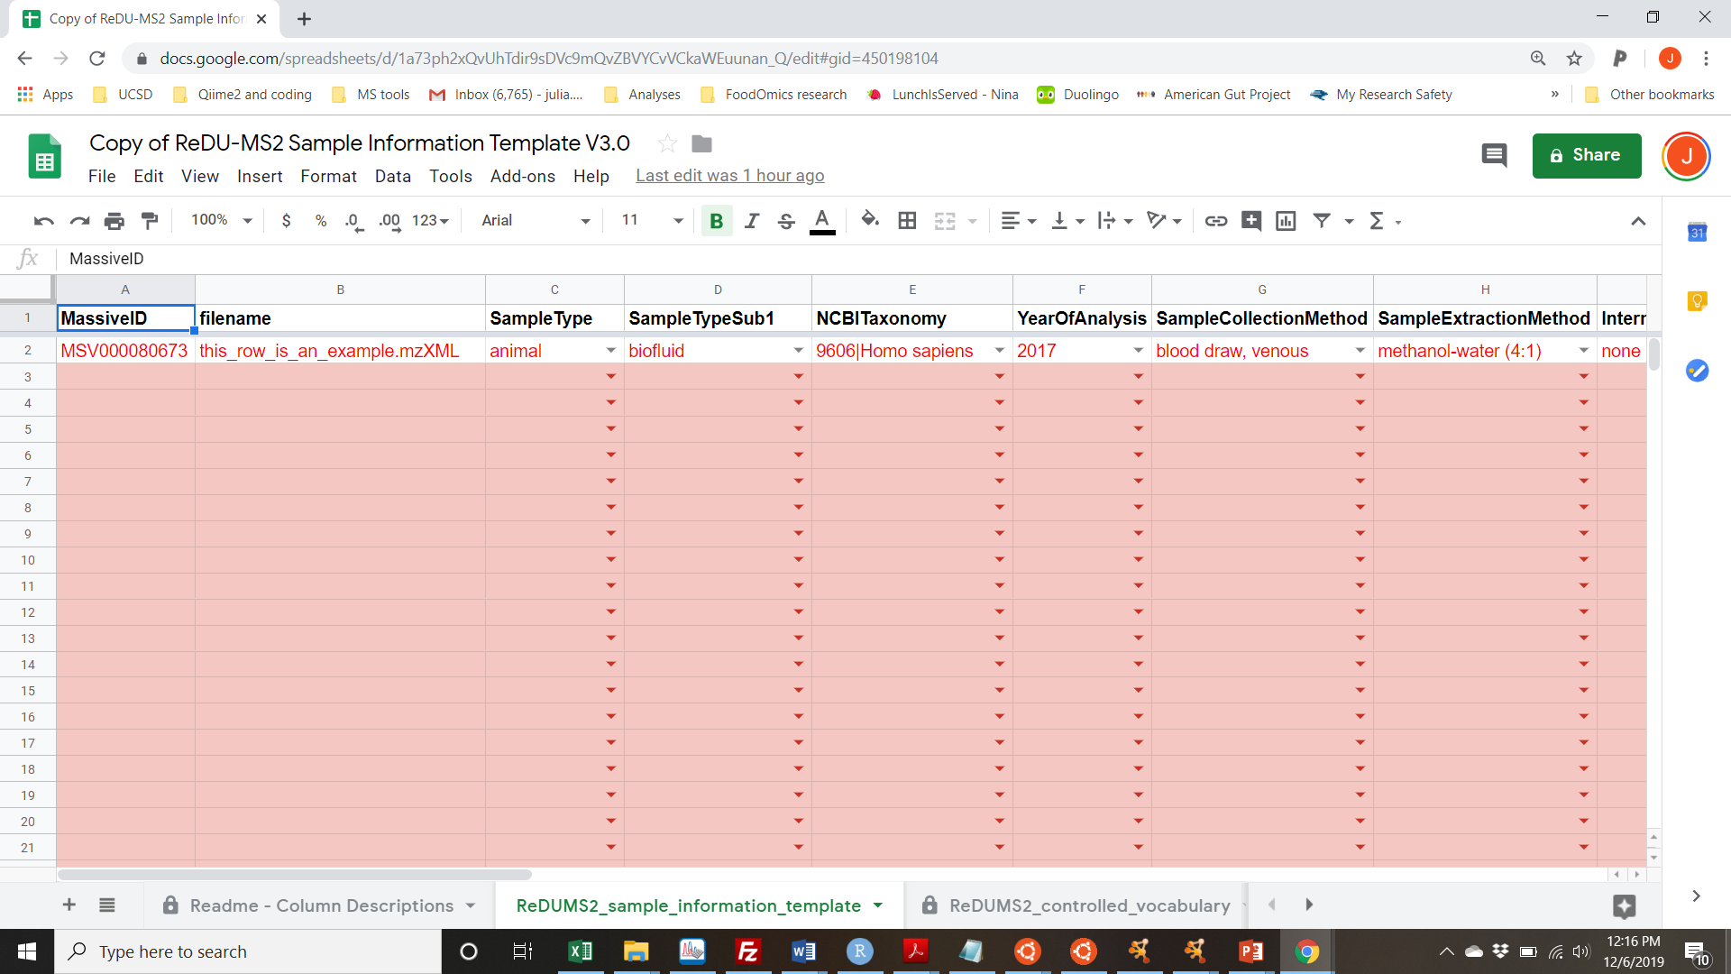
Metadata

Slide 29
Adding metadata to GNPS-MassIVE dataset
Same groups for ReDU module - 7 tomorrow
ReDU

